Slide 1
Week 5
Long-term Memory
Alternative Models of Memory

Slide 2
Smell Test
I will pass around a bag containing a smell
Write down your recollections related to the smell.
Notes:
Older people will say denistist
Emotional link here
Herbal sweets, granny’s apple pie, xmas are often recalled.

Slide 3
Long -Term Memory
Has a fairly infinite capacity?
Does this mean we remember everything
Memories last between minutes and years.
Contains knowledge, social norms, language skills, beliefs and problems solving skills.
Information is often coded semantically
Notes:
Make point this is where discussion and level 3 thinking starts

Slide 4
What is meant by Semantically.
Class exercise
Split into small groups and discuss the following topics.
1: A film one of you have seen recently
2: Your first day at college

Slide 5
What is meant by Semantically.
Class exercise
1: A film one of you has seen recently
2: Your first day at college
How did you describe these things?
Was it pure data (as the Atkinson Shiffrin model would suggest)?
What links to other things did you make?
Would the Atkinson Shiffrin model adequately explain how an athlete remembers their skills?
Notes:
Semantic memory is the idea that we need to make sense of things by finding an understanding and making links to other things.

Slide 6
Evaluation of the Atkinson Shiffrin Model
General agreement that there are differences between short and long-term memory and this model is the basis for other memory models.
However, rehearsal is not the only way information passes into the LTM. The levels of processing model might be a better explanation.
The model is over simplified
It represents a passive view of memory.

Slide 7
A model for Semantic Memory
The level of processing model
Craik and Lockhart (1972)
Lets look at the word LOP (to cut off, as in pruning trees)
We might process the word like this:
Alphabet => Does the word contain symbols we recognise => Is this a word in our personal dictionary (lexicon) => Might it be an abbreviation as it is shown in capitals (level of processing?) => Do we understand the word => does it have different meanings in different contexts.
Notes:
This model suggests that memories are dependent upon the degree of processing of information. But some thinks stick out. Do we process novel things more deeply.
Think of your note taking and copying up notes and actively getting involved with Learning.
Link to exercises from last week

Slide 8
Collins and Quillian (1969)
They argue that knowledge can be in the form of a fact. Paris is the capital of France.
What about the question?
Do canaries have lungs?
Does a frog have a neck?
How do we work this out?

Slide 9
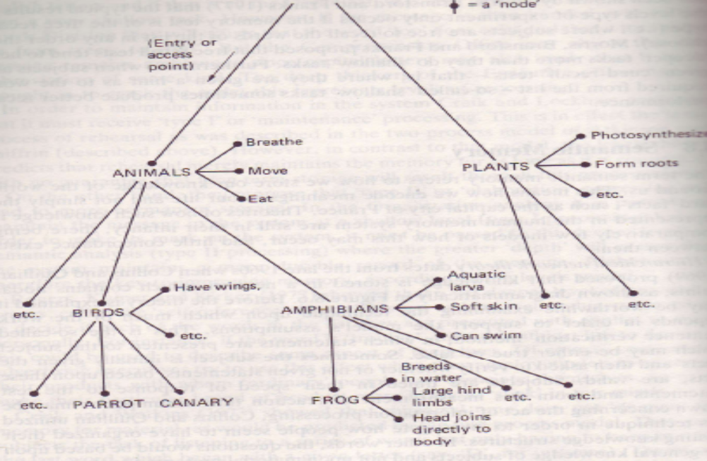
Hierarchical Model
Notes:
Looking at this model we can see that each node represents a point of knowledge. So the canary question can be answered as we know animals breath, a bird is an animal, a canary is a bird so it must breath and to do this it needs lungs.
Can any one think of another link. I had thought of canaries in mines, gas, canary dies if there is too much carbon dioxide, so it must breath and therefore have lungs.
Do you think this type of model better explains the short comings of the Atkinson Shiffrin model.
Link to mind maps – tony buzan

Slide 10
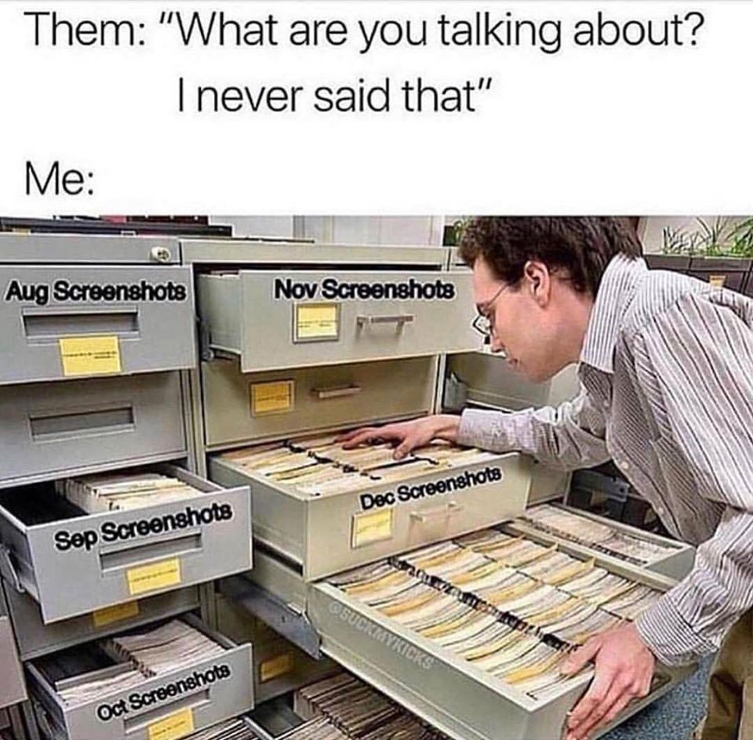

Slide 11
Working Memory Model
Develops on the two stage model.
Hitch and Baddeley (1971)
The STM (short-term memory) has different components
Confirmed by Shallice and Warrington (1970)
Keith Moon https://www.youtube.com/watch?v=rjuRRUpvms8
Also https://www.youtube.com/watch?v=6sHoWTM-8s8
about 30 seconds in
Notes:
The working memory model suggests that there is a central executive that allocates resources. When people sing and play the piano it is difficult to do both at the same time to the same level as when doing one only.
Hitch and Baddeley found that it was difficult to do a verbal reasoning task when counting backwards, but not when reaping the same word again and again.
However, we can do some tasks at the same time if they draw on different parts of the brain. Drive and talk to a passenger.
This suggests that the STM has different components. Shallice and Warrington (1970) studies a person known as KF who was involved in a motorcycle accident. His STM for auditory stimuli was not affected by the accident, but his visual STM was. KF could remember meaningful sounds, but not words.
Look at the drummer (Keith Moon) he is practicing his moves before his part.

Slide 12
Review
Atkinson Shriffrin made a good model, but it has limitations
Other models can explain certain aspects of memory, but no one model makes up a full explanation.
Now we will examine the Short Term Memory for ourselves
Notes:
Atkinson Shriffrin made a good model, but it does not explain motor skill memory or any emotional or semantic content within memories.
Alternative suggestions might better explain certain aspects, but not everything. Level of processing shows that memories can pass from STM to LTM when the level of processing increases.
The hierarchical model can explain links we make between memories and how we can develop knowledge from fragmented information.
The working memory model explains about attention and suggests that the STM is more complex than the Atkinson shiffrin model.
Next week we will look at forgetting.

Slide 13
Memory Exercises
Mnemonics – making up acronyms to help remember things
What ones do you use at work
Notes:
Bases in DNA AT GC
At Gloucestershire College
MRS GREN – biology
BODMAS – maths
Cheeky The Lion Sniffs Cocaine – order of vertebrae

Slide 14
Make Up a Story
See exercise in work book

Slide 15
Memory Exercises
Position of Loci
Place items on the list on the street in your imagination, now go and pick them up.
How many remembered now?
Derren Brown https://youtu.be/vJ1bw_ipcL8
Notes:
More than 7 as STM would suggest

Slide 16
